Slide 1




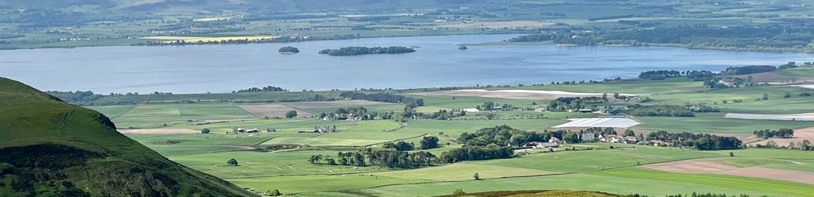
Investigating the seasonality and environmental drivers of phytoplankton blooms in Loch Leven
Using Linear Modelling and Random Forest Regression
Ariel Koh
s2227491@ed.ac.uk
1 May 2025
James Watt
This Photo by Unknown Author is licensed under CC BY-SA

Slide 2
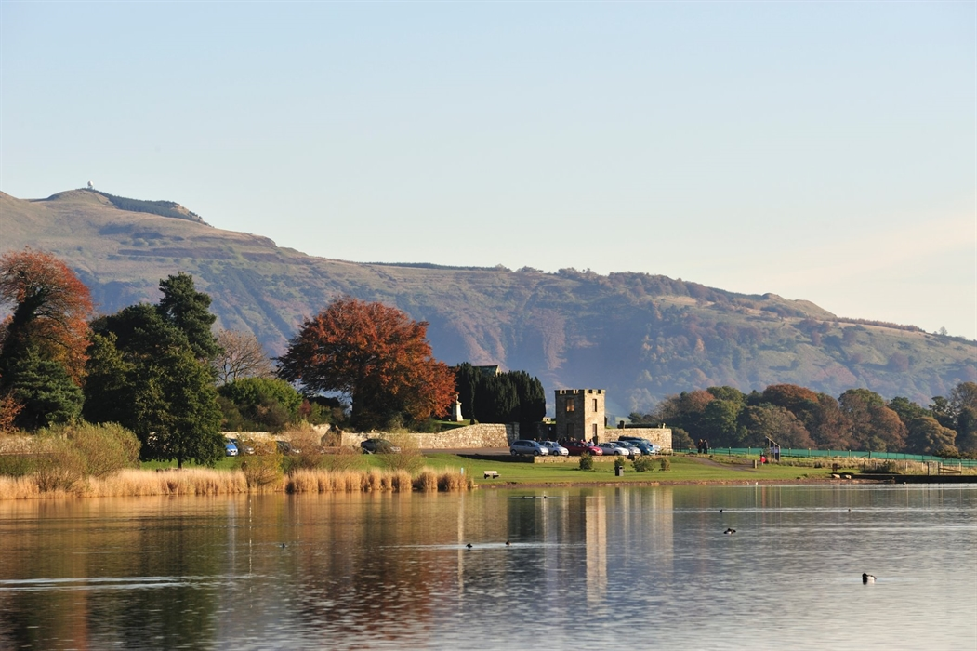
Contents
1
Background: Phytoplankton, Harmful Algal Blooms, Loch Leven
Knowledge Gap, Aims, Research Question
Methods: A Brief Overview
Results: What did we find?
Discussion: Interpreting the Findings
Management Implications, Limitations, Future Research
2
3
4
5
6

Slide 3
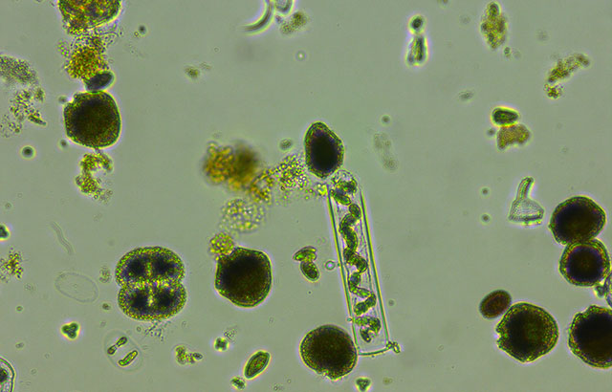
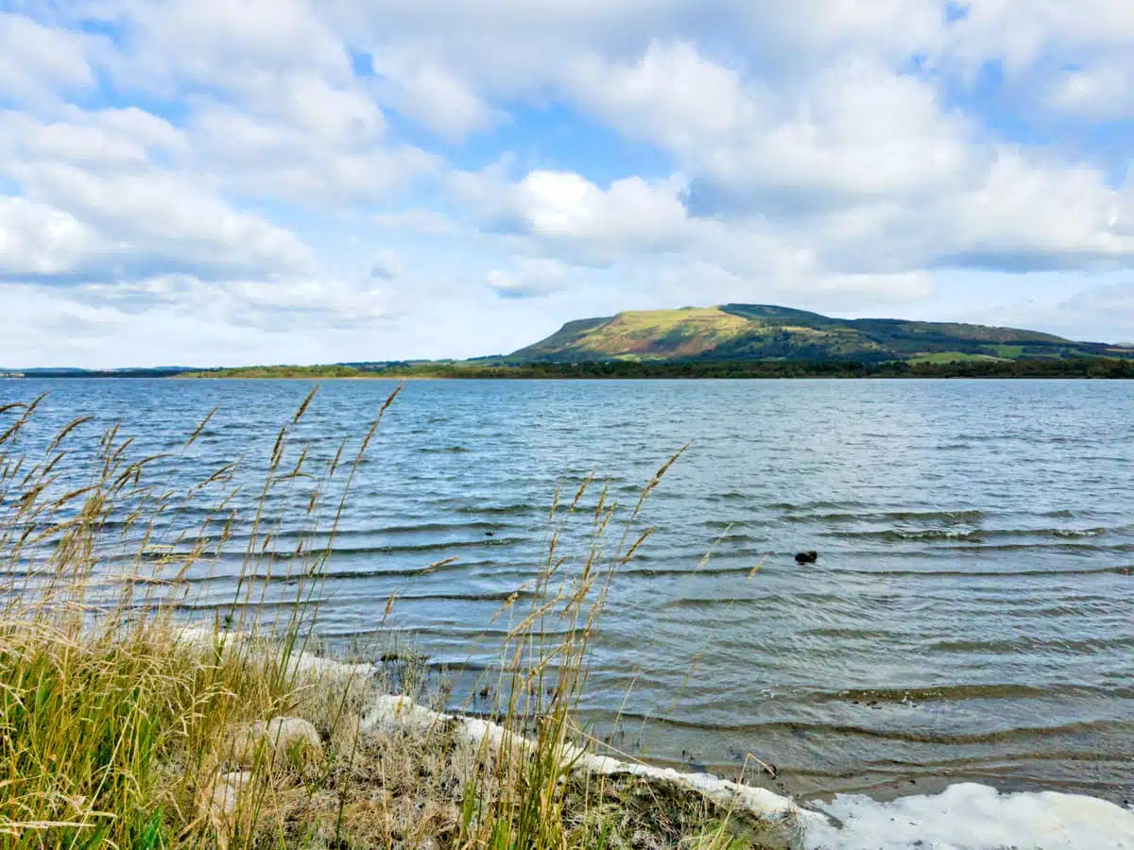
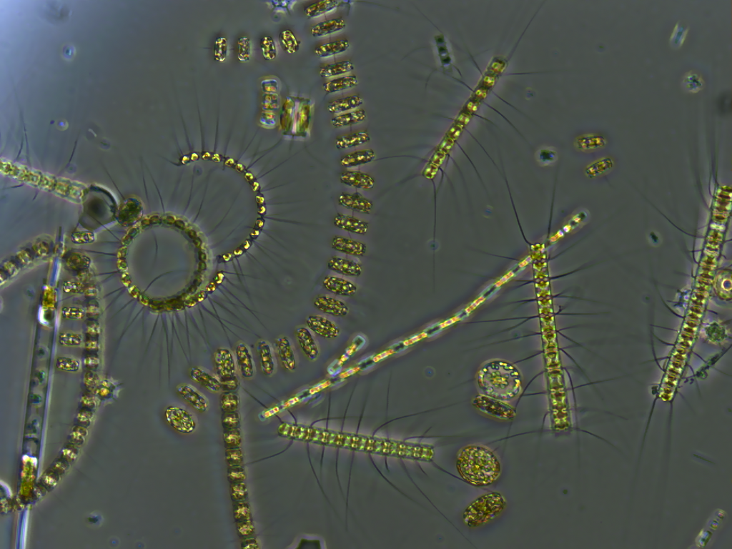
Ecological Significance of Phytoplankton
Phytoplankton are:
key primary producers
provide a major source of biodiversity
key indicators of aquatic ecosystem health (Monier et al., 2015)
1
Notes:
key primary producers - less than 1% of earth's photosynthetic biomass - contribute ~50% of net primary production/net oxygen production
major source of biodiversity - taxonomically and functionally diverse
growth rate and die off rate - responds rapidly to changes in the environment - used in studies as key indicators of ecosystem health

Slide 4
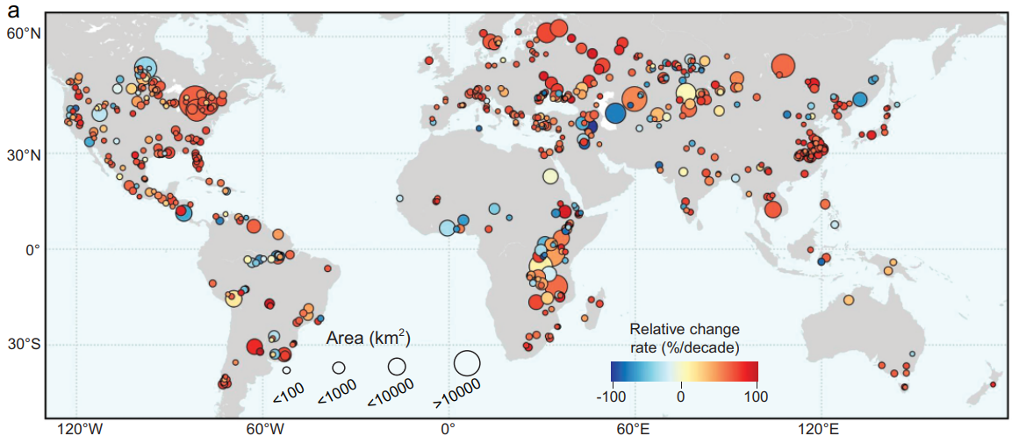
Harmful Algal Blooms
Global trend of algal blooms in large freshwater lakes between 2003 and 2022 (Wang et al. 2025)
2
Notes:
depsite being an essential part of ecosystems
under certain conditions - can exponentially increase - forming harmful algal blooms
Threat to freshwater
more frequent and more intense
all around the world

Slide 5
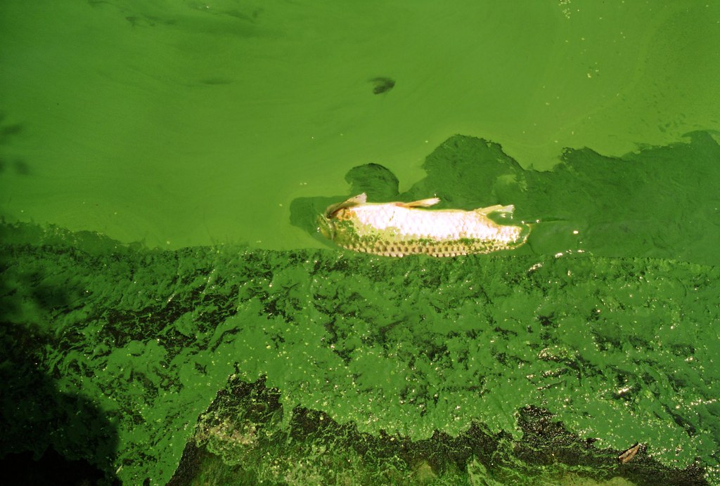

Harmful Algal Blooms
Death
Increase in phytoplankton abundance
Death
“Dead Zones”
Increase in DOM
Halogenation
Disinfection process
Disinfection Byproducts (DBP)
3
Notes:
why is it so harmful?
a large amount of phytoplankton die - increase in decompostion
consume all the oxygen in the water column - creating dead zones
aquatic life cannot survive
rapid die off - increase in dissolved organic matter
can react in the disinfection process to form disinfection byproducts - carcenogenic

Slide 6
Drivers of Phytoplankton Bloom
Chemical Drivers
Phosphorus
Nitrate
Physical Drivers
Temperature
Stratification
Biological Drivers
Zooplankton Grazing
TOP-DOWN VS BOTTOM-UP DEBATE
These drivers are not temporally constant and do not act in isolation.
Phytoplankton Bloom
4
Notes:
there is still no clear understanding of main drivers of phytoplankton blooms and how they interact
main ones are chemical drivers, physical drivers, biological drivers
it is important to notes that - not temporally constant and do not act in isolation
there is still an ongoing debate
are phytoplankton blooms controlled by their predators – grazing pressure
or is their growth limited by nutrients available to them - bottom up theory

Slide 7
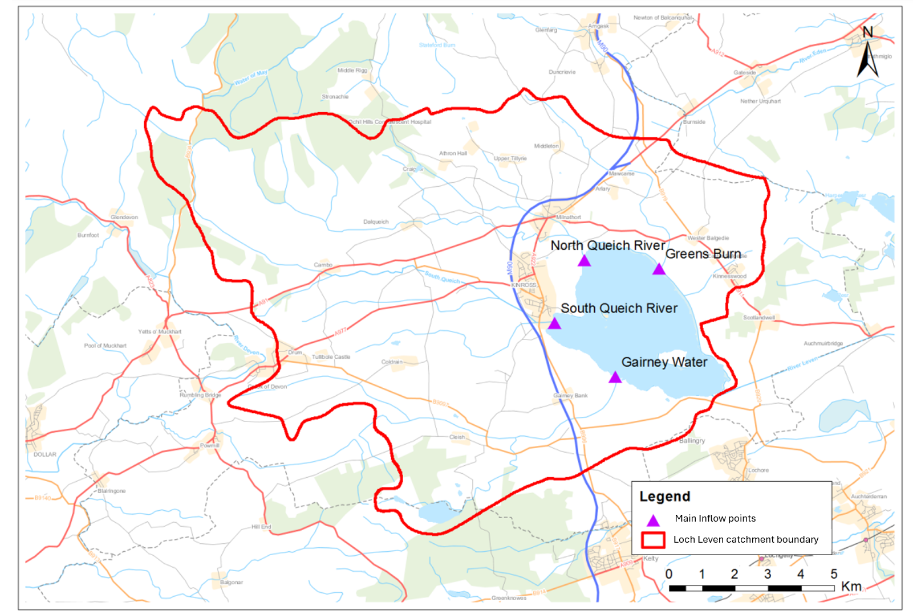
Loch Leven: A Model System
Outflow
5
Notes:
Why use Loch Leven?
largest shallow lake in the UK
extensive monitoring record starting in 1963
historically - has faced nutrient input from kinross, industry and surrounding agriculture
currently - heating up at a high rate (shallow) and has been shown to be affected by climate change
considered a sentinel system - responds rapidly to environmental pressure - early warning system

Slide 8
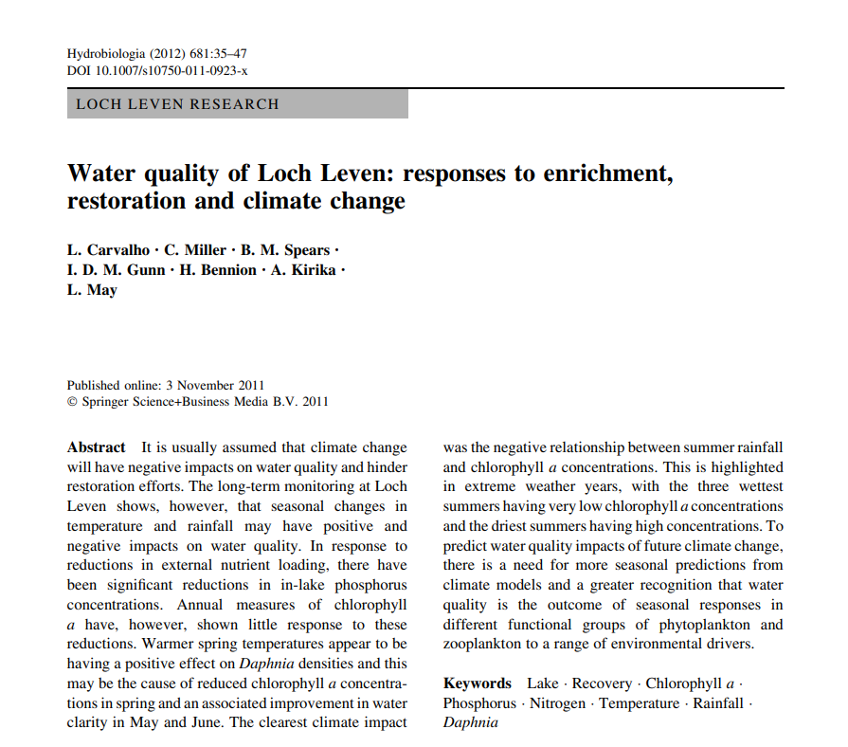
Knowledge Gap
Most studies employ either traditional statistical models or machine learning techniques independently
The most recent comprehensive study on Loch Leven’s phytoplankton dynamics covers data only up to 2007 (Carvalho et al. 2011)
6
Notes:
what is the knowledge gap we are trying to fill?
older more traditional studies statistical models like linear modelling
while newer studies focus on machine learning techniques such as random forest
there are limited studies that integrate both techniques
most recent study on phytoplankton dynamics in Loch leven covers data up to 2007 - basically add on a decade of data to 2016

Slide 9
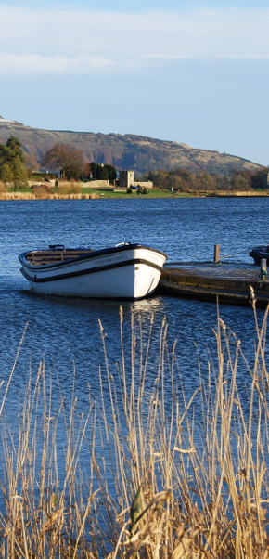
Aim & Research Questions
AIM:
Investigate the seasonality and environmental drivers of algal blooms and phytoplankton community composition in Loch Leven
RESEARCH QUESTIONS:
How does seasonality influence the occurrence of algal blooms within Loch Leven?
What are the chemical and physical drivers of algal blooms in the Loch?
How do environmental drivers influence the composition of phytoplankton communities within Loch Leven?
7

Slide 10

Methods: Dataset
Dataset (2004-2016) obtained from UKCEH (N=2528)
Water quality
Nutrient concentrations
Temperature
Daphnia density
Phytoplankton biovolume
8

Slide 11
Methods
What are the chemical and physical drivers of algal blooms in the Loch?
Linear Modelling
Fixed effects were added in a stepwise manner
Model selection using AIC and conditional R² values
9

Slide 12
Methods
What are the chemical and physical drivers of algal blooms in the Loch?
Linear Modelling
Fixed effects were added in a stepwise manner
Model selection using AIC and conditional R² values
Random Forest Regression
Machine learning model
Ranks which predictors are most important
9

Slide 13
Methods
How do environmental drivers influence the composition of phytoplankton communities within Loch Leven?
Group-specific Phytoplankton Biovolume Analysis against Daphnia Densities
Spearman’s correlation analysis
10

Slide 14
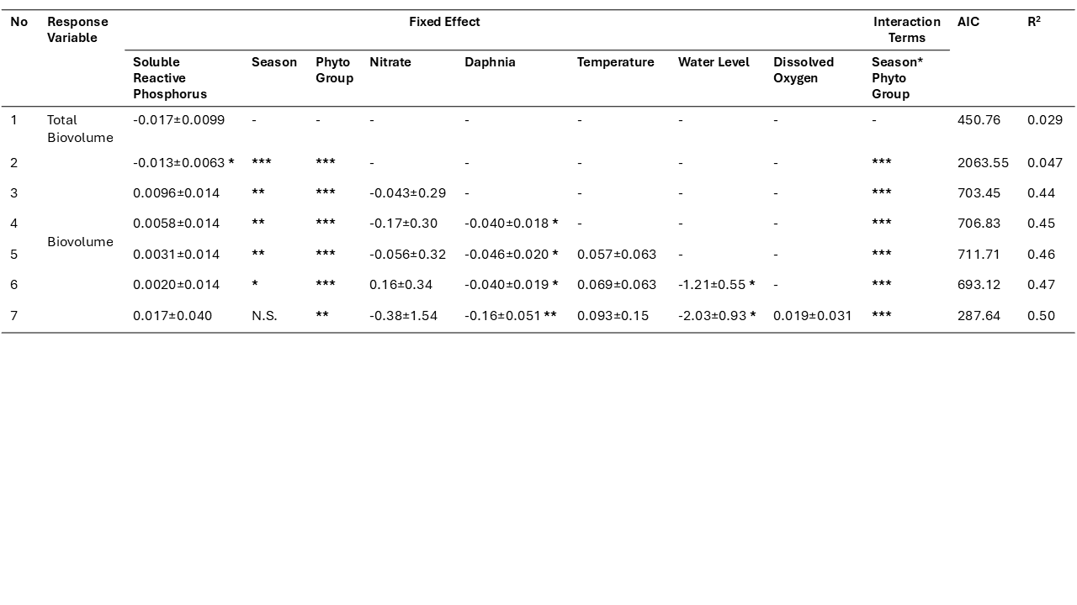
Results: Drivers of Algal Bloom – Linear Modelling
Summary of linear model outputs evaluating the influence of environmental, seasonal, and biotic factors on phytoplankton biovolume.
11
Notes:
shows the linear models i constructed and their outputs, AIC and R2
more * means more significant
NS means not significant
higher R2 means higher variance in the dataset explained by the predictors
lower AIC means better fit
AIC generally decreasing - meaning we are not overfitting - YAY
best fitting model is mod 7

Slide 15
Results: Drivers of Algal Bloom – Linear Modelling
Model 7 is the best fitting model; these are its outputs evaluating the influence of environmental, seasonal, and biotic factors on phytoplankton biovolume.
Significant negative relationship: Daphnia and water level
Significant relationship: Phytoplankton group & Season*Phytoplankton group
12
Notes:
lets take a closer look at mod 7
can see that daphnia and water level both have a significant negative relationship with phytoplankton biovol
and despite the fact that season on its own is not significant
phytoplankton group and the interaction between phytoplankton group and season were found to be significant

Slide 16
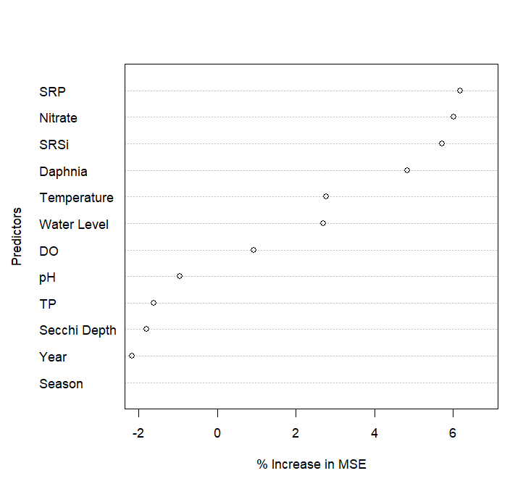
Results: Drivers of Algal Bloom – Random Forest
13
Notes:
random forest ranks predictors based off which is has the most influence on phytoplankton biovolume – higher value = more important
In this instance - SRP Nitrate and SRSi are the strongest predictors

Slide 17
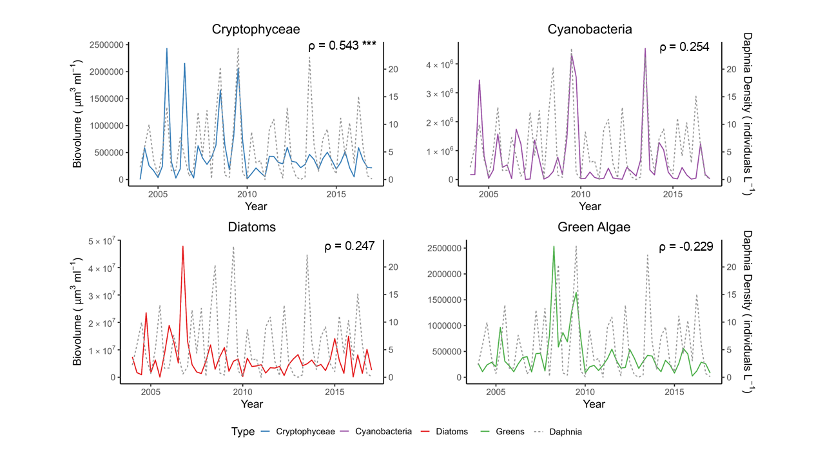
Results: Daphnia Densities and Phytoplankton Groups
14
Notes:
plot of each phytoplankton group's biovolume against daphnia densities throughout the years
spearman's correlation was conducted
crytophyceae was the only significant relationship - positively correlated
cyanobacteria and diatoms were also positively correlated
green algae was negatively correlated
none of the latter 3 reached statistical significance

Slide 18
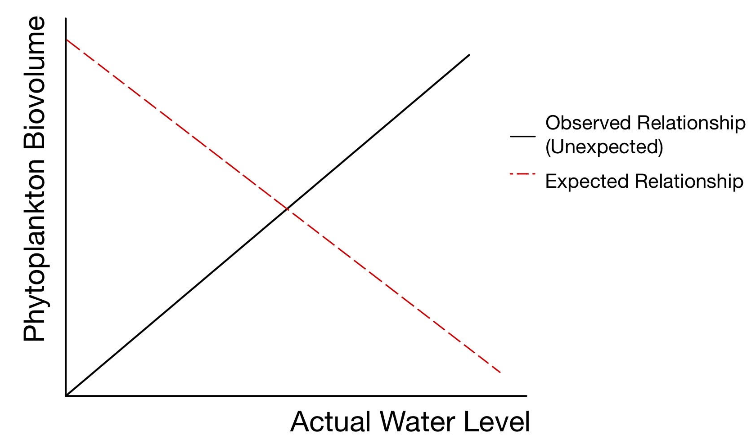
Discussion: Environmental Drivers – Linear Model
Daphnia density – aligning with top-down control theory (Jeppesen et al., 1997)
Phytoplankton group & Season*Phytoplankton group – in line with phytoplankton seasonal succession theory (Sommer et al., 2012)
Water level:
Measured as the distance from the top of Kinross pier to the water surface
A smaller measured distance = a higher actual water level
Actual water level ∝ phytoplankton biovolume
Opposing research that found higher water level = higher flushing rate of blooms (Carvalho et al., 2012)
Could be due to sediment resuspension (Da Costa et al. 2015)
15
Notes:
The negative relationship daphnia and phytoplankton - aligns with top-down theory
daphnia can exert pressure on phytoplankton biovol by feeding on them
the phytoplankton group and its interaction with season were both found to be significant
in line with broader ecological theories of phytoplankton seasonal succession
that different taxonomic groups showed distinct seasonal biovolume patterns
water level measured from the top of Kinross pier to the water surface
a smaller measured distance = higher water level
actual water level proportional to biovol
interesting - opposes research usually higher waterlevel=less bloom, due to flushing rate
other studies - lower water level = more sediment resuspension due to wind + fish movement = worse conditions for blooms

Slide 19
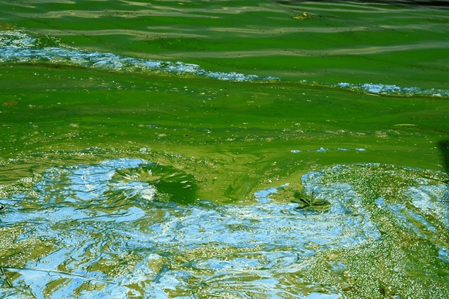
Discussion: Environmental Drivers – Random Forest
SRP & Nitrate
Well established limiting nutrients
Most readily bioavailable form
Potential for nutrient colimitation (Andersen et al., 2020)
SRSi – key component of diatoms’ cell walls (Shatwell et al. 2013)
16
Notes:
Results for the random forest highlight nutrients as most important predictors - supports the bottom-up theory
SRP and Nitrate limiting nutrients - both raking highly = potential for nutrient colimitation in loch
SRSi - key for diatoms to build cell walls - especially important during colder seasons when diatoms dominate

Slide 20
Discussion: Traditional Modelling vs Machine Learning
LINEAR MODELLING | RANDOM FORESTS
Simple + Transparent Replicable | “Black Box” Outputs can vary slightly
May miss non-linear and complex patterns (James et al., 2013) | Captures complex relationship and interactions (Breiman, 2001)
17
Notes:
due to lm being simpler + transparent and replicable - its very important in research for hypothesise testing
due to the way rf are built - with the may decision trees - it has a reputation of being a black box - not very interpretable - no effect size and p values
outputs can also vary slightly on each run - due to machine learning technique
however there is an assumption of linearity in lm - so might miss non-linear patterns
random forest is a non parametric approach can detect more complex nonlinear relationships and interactions

Slide 21
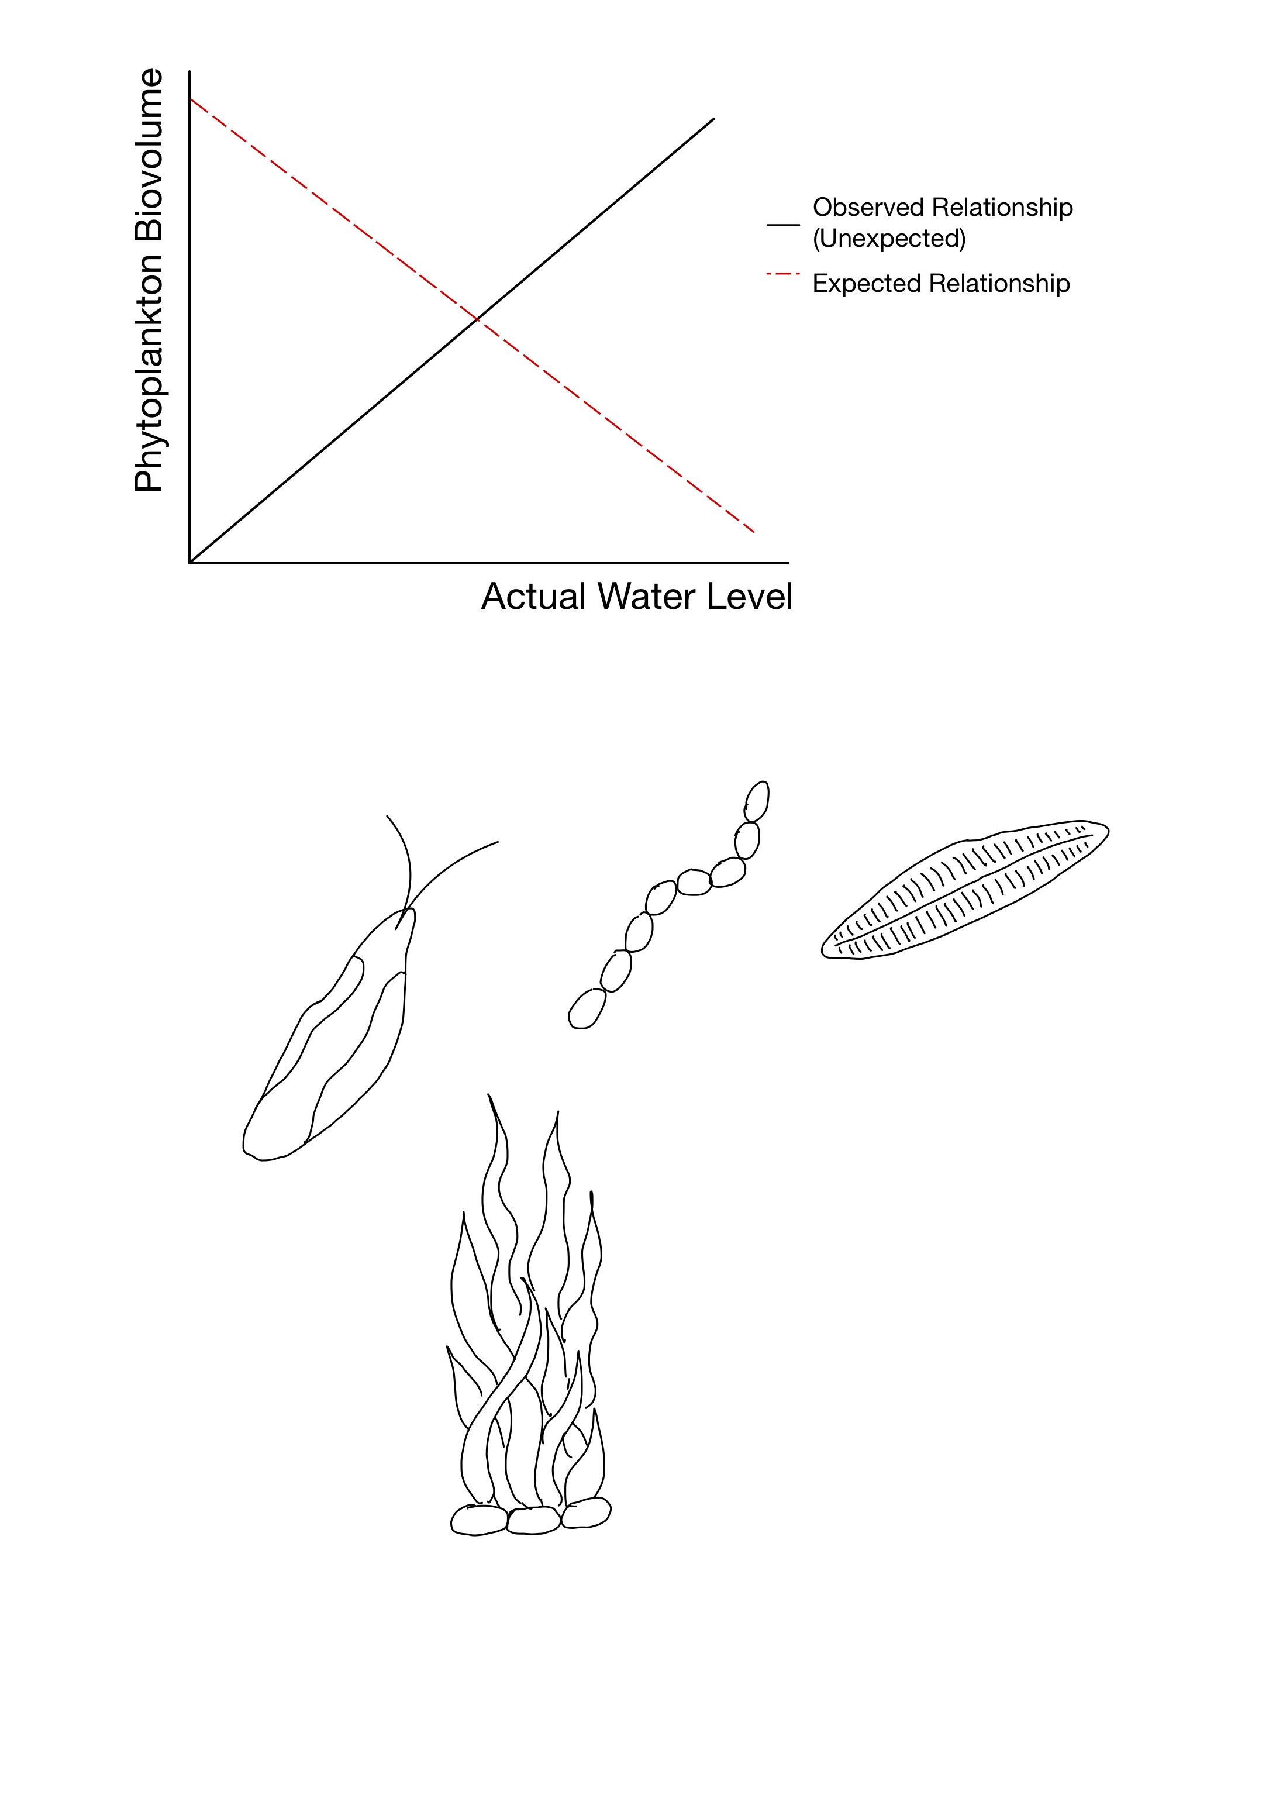
Discussion: Group-Specific Relationships with Daphnia
Phytoplankton Group
Relationship
Explanation/Mechanism
Cryptophyceae
Significantly
Positive ↑
Nutritious food source
Supports bottom-up theory
Negative ↓
(Not significant)
Green Algae
Top-down grazing theory
Cyanobacteria
Poor-quality food – toxic and filamentous
Positive ↑
(Not significant)
Sinks out of feeding zone – not easily grazed
Diatoms
18
Notes:
cryptophyceae is a nutritious food source- daphia's preferred in fact - so when biomass increases daphnia will have more to consume hence increases as well - supports the bottom up theory
green algae having a negative relationship supports the bottom down theory - however it is statistically insignficant
cyanobacteria +diatoms insignficant relationship - cyanobacteria toxic and filamentous no good to eat + diatoms regularly sink otu of feeding zone - not easily grazed

Slide 22
Limitations & Future Research
Limitations:
Substantial data gaps especially in later years
Taxonomic resolution of phytoplankton groupings
Future Research:
Applying similar modelling to other shallow lakes
Expanding temporal coverage and improving data continuity
Addition of more environmental drivers ( esp. meteorological data)
19
Notes:
substantial data gaps in our dataset in the later years - reduced out dataset numbers significantly - might have affected the accuracy of the models
taxonomic resolution - the phytoplankton groups were done at a class/phylum level - which might have oversimplified - might be overlooking species specific interactions/behaviours
if its generalisable trend
improving accuracy and predictive power
generalise additive models to look at interactions and non-linear relationships
demonstrate that phytoplankton community dynamics in Loch Leven are influenced by the interaction between physical, chemical and biological drivers
Effective lake management of phytoplankton blooms will therefore require integrated solutions

Slide 23
QUESTIONS?
Ariel Koh
s2227491@ed.ac.uk
1 May 2025
James Watt
Notes:
demonstrate that phytoplankton community dynamics in Loch Leven are influenced by the interaction between physical, chemical and biological drivers
Effective lake management of phytoplankton blooms will therefore require integrated solutions

Slide 24
References
Andersen, I.M. et al. (2020) ‘Nitrate, ammonium, and phosphorus drive seasonal nutrient limitation of chlorophytes, cyanobacteria, and diatoms in a hyper‐eutrophic reservoir’, Limnology and Oceanography, 65(5), pp. 962–978. Available at: https://doi.org/10.1002/lno.11363.
Breiman, L. (2001) ‘Random Forest’, Machine Learning, 45(1), pp. 5–32. Available at: https://doi.org/10.1023/A:1010933404324.
Carvalho, L. et al. (2012) ‘Water quality of Loch Leven: responses to enrichment, restoration and climate change’, Hydrobiologia, 681(1), pp. 35–47. Available at: https://doi.org/10.1007/s10750-011-0923-x.
Da Costa, M.R.A., Attayde, J.L. and Becker, V. (2016) ‘Effects of water level reduction on the dynamics of phytoplankton functional groups in tropical semi-arid shallow lakes’, Hydrobiologia, 778(1), pp. 75–89. Available at: https://doi.org/10.1007/s10750-015-2593-6.
James, G. et al. (2013) An Introduction to Statistical Learning. New York, NY: Springer New York (Springer Texts in Statistics). Available at: https://doi.org/10.1007/978-1-4614-7138-7.
Jeppesen, E. et al. (1997) ‘Top-down control in freshwater lakes: the role of nutrient state, submerged macrophytes and water depth’, Hydrobiologia, 342/343, pp. 151–164. Available at: https://doi.org/10.1023/A:1017046130329.

Slide 25
References
Monier, A. et al. (2015) ‘Oceanographic structure drives the assembly processes of microbial eukaryotic communities’, The ISME Journal, 9(4), pp. 990–1002. Available at: https://doi.org/10.1038/ismej.2014.197.
Shatwell, T., Köhler, J. and Nicklisch, A. (2013) ‘Temperature and photoperiod interactions with silicon-limited growth and competition of two diatoms’, Journal of Plankton Research, 35(5), pp. 957–971. Available at: https://doi.org/10.1093/plankt/fbt058.
Sommer, U. et al. (2012) ‘Beyond the Plankton Ecology Group (PEG) Model: Mechanisms Driving Plankton Succession’, Annual Review of Ecology, Evolution, and Systematics, 43(1), pp. 429–448. Available at: https://doi.org/10.1146/annurev-ecolsys-110411-160251.
Wang, Y. et al. (2025) ‘Global elevation of algal bloom frequency in large lakes over the past two decades’, National Science Review, 12(3), p. nwaf011. Available at: https://doi.org/10.1093/nsr/nwaf011.

Slide 26
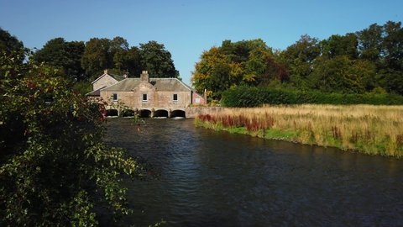
Management Implications
Need integrated solutions:
Manage nutrients carefully
Use sluice gates for water level control
Support zooplankton grazers like Daphnia
Predator management
Clearer water conditions
Notes:
multi faceted sotuions
loch leven has already gone through a lot of restoration and controlling of nutrient inputs - this continues to be important as shown by the rf results
need to think about internal loading as well as this has been an issue in loch leven and other similar lochs
loch leven already has a sluice gate installed - maybe consider using this to control water level during seasons of high algal bloom risk
potentially can also look into supporting grazers - through optimising grazing conditions - reduction in their predators + clearer water conditions
but all these will also be affected by climate change - so we need to be adaptable with our strategies

Slide 27
How do Random Forests work?
Original Dataset
Bootstrapped Dataset
Decision Tree 1
Decision Tree 2
Decision Tree 3
Aggregate Predictions
Notes:
1. Build multiple Decision Trees
Bootstrap the data: Randomly sample with replacement.
Random subset of variables at each split (feature randomness).
2. Aggregate Predictions
Each tree votes → majority vote (classification) or average (regression).
3. Evaluate
Use Out-of-Bag (OOB) Error: Predict samples not seen by each tree.

Slide 28
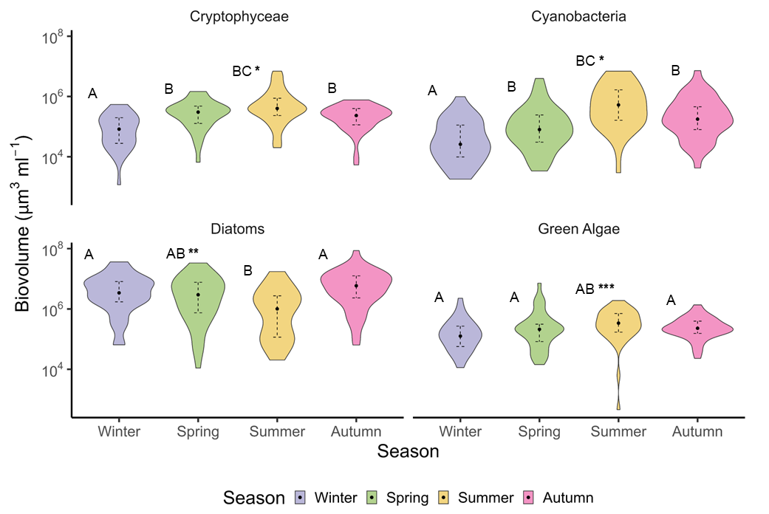
Seasonality of Phytoplankton Groups

Slide 29
Seasonality of Phytoplankton Groups
Mod No | Intercept | Season |  |  | Phytoplankton Group |  |  | Season*Phytoplankton Group
 | Cryto : Winter | Spring | Summer | Autumn | Cyano | Diatoms | Greens | Cyano : Spring | Diatoms: Spring | Greens: Spring | Cyano : Summer | Diatoms : Summer | Greens : Summer | Cyano : Autumn | Diatoms : Autumn | Greens : Autumn
1 | - | - | - | - | - | - | - | - | - | - | - | - | - | - | - | -
2 | 11.23± 0.29 *** | 1.26± 0.36 *** | 1.86± 0.36 *** | 1.08± 0.36 ** | -0.94± 0.38 * | 3.82± 0.38 *** | 0.58± 0.38 | -0.13± 0.51 | -1.78± 0.50 *** | -0.80± 0.50 | 0.94± 0.51 | -3.44± 0.50 *** | -1.07± 0.50 * | 0.92± 0.51 | -0.64± 0.51 | -0.40± 0.51
3 | 10.11± 0.78 *** | 2.04± 0.74 ** | 2.60± 0.84 ** | 1.01± 1.08 | -0.14± 0.78 | 5.20± 0.76 *** | 1.39± 0.76 | -1.02± 1.06 | -3.06± 1.03 ** | -1.46± 1.03 | 0.40± 1.06 | -5.05± 1.03 *** | -2.06± 1.03 * | 1.01± 1.08 | -1.20± 1.06 | -0.87± 1.06
4 | 10.44± 0.79 *** | 2.24± 0.74 ** | 2.68± 0.83 ** | 1.38± 0.88 | -0.12± 0.77 | 5.20± 0.75 *** | 1.39± 0.75 | -1.01± 1.05 | -3.07± 1.02 ** | -1.46± 1.02 | 0.34± 1.04 | -5.05± 1.02 *** | -2.06± 1.02 * | 0.99± 1.06 | -1.19± 1.05 | -0.86± 1.05
5 | 10.06± 0.89 *** | 2.03± 0.77 ** | 2.12± 1.03 * | 1.13± 0.92 | -0.13± 0.77 | 5.20± 0.75 *** | 1.39± 0.75 | -0.99± 1.06 | -3.07± 1.02 ** | -1.46± 1.02 | 0.35± 1.04 | -5.05± 1.02 *** | -2.06± 1.02 * | 1.02± 1.07 | -1.18± 1.05 | -0.85± 1.05
6 | 139.42± 58.95 * | 1.97± 0.76 * | 2.32± 1.04 * | 0.97± 0.91 | -0.10± 0.76 | 5.20± 0.74 *** | 1.39± 0.74 | -1.06± 1.05 | -3.07± 1.01 ** | -1.46± 1.01 | 0.12± 1.06 | -5.41± 1.03 *** | -2.31± 1.03 * | 1.02± 1.05 | -1.14± -1.04 | -0.82± 1.04
7 | 226.14± 100.19 * | 2.17± 1.73 | 1.64± 1.95 | -0.88± 2.20 | 0.56± 1.83 | 5.81± 1.83 ** | 0.34± 1.83 | -1.91± 2.24 | -3.70± 2.24 | -0.005± 2.24 | -1.43± 2.11 | -6.42± 2.11 ** | -1.91± 2.11 | 0.52± 2.16 | -1.20± 2.16 | 0.56± 2.16

